Slide 1
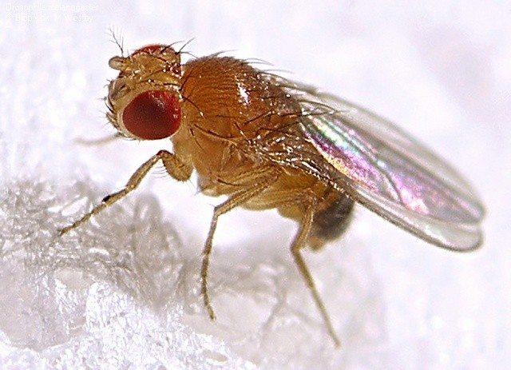
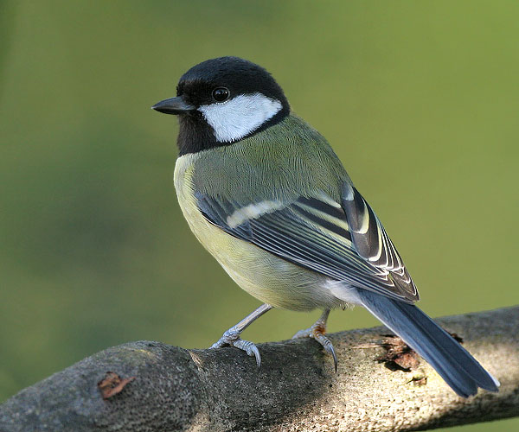

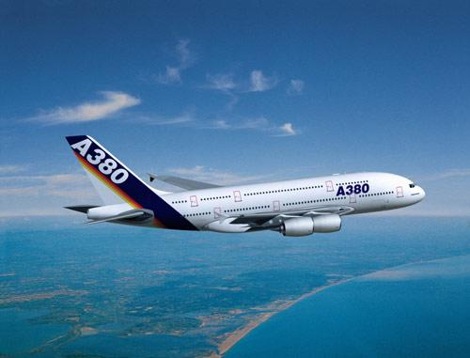
On The Hidden Nature of Complex Systems Tradeoffs, Architecture, Nets, Grids, Bugs, Brains, and the Meaning of Life
David Meyer
CTO and Chief Scientist, Brocade
Director, Advanced Technology Center, University of Oregon
NANOG 61
June 02-04 2014
Bellevue, WA
dmm@{brocade.com,uoregon.edu,1-4-5.net,…}
http://www.1-4-5.net/~dmm/talks/nanog61.pptx

Slide 2
Agenda
Too many words, too many slides ☺
This talk is about thinking about networking in new ways
Motivation and Goals for this Talk
What is Complexity and Why is it Hidden
Robustness, Fragility, and Complexity
The Architecture of Complex Systems
Universal Architectural Principles
A Few Conclusions and Q&A if we have time

Slide 3
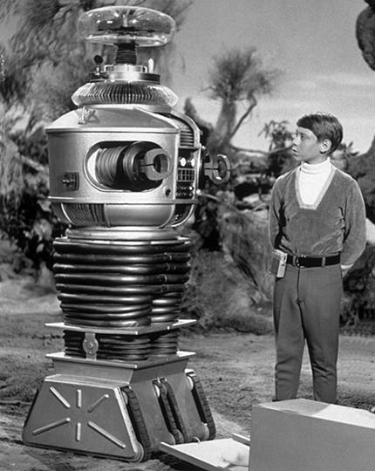
Danger Will Robinson!!!
Standard Disclaimer
This talk might be controversial/provocative
(and perhaps a bit “sciencey”)

Slide 4
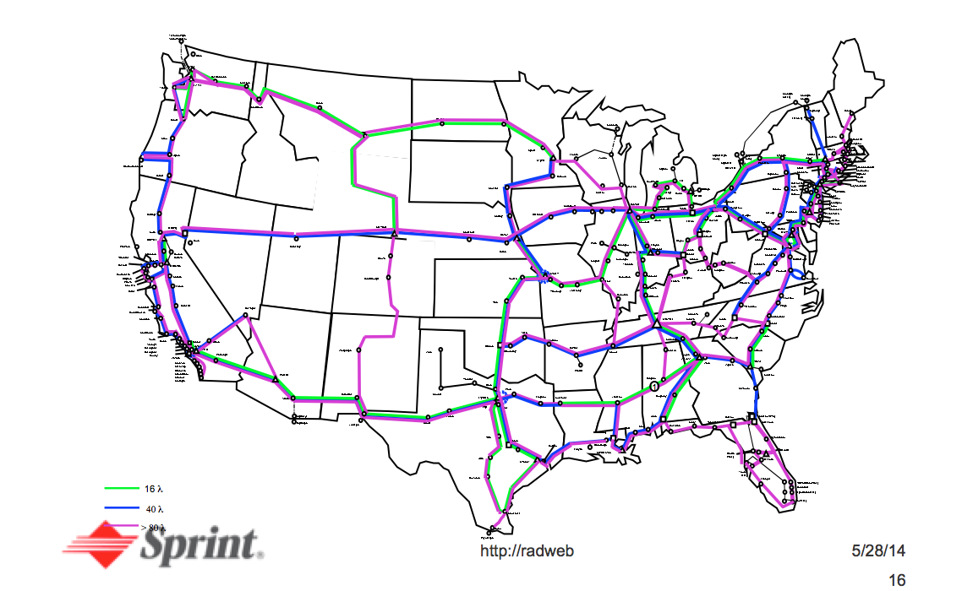
So How Did I Get Involved In All Of This Complexity Stuff?
It all started here, circa 2000

Slide 5
What Happened?
Somewhere around 2000 I was re-org’ed to report up through Kansas City
along with all of the Sprintlink folks
Kansas City was famously the home of Pin Drop, ATM, Frame Relay, TDM, and the like
We had been talking about how IP was so much “simpler” that FR/ATM/TDM/.. Predictably, first question I was asked by the KC folks was:
If the IP network is so much simpler, why is its OPEX/CAPEX profile so much higher (than ATM, FR, or TDM)?
I could not answer this question
Seriously, I had no clue
There was all kinds of talk about FCAPS, NMS, etc, but none of it was helpful/quantitative
So I set out to understand how I might answer it
First by surveying the “complexity” literature
And BTW, what was complexity?
And surely there was a quantitative way to compare circuit and packet switched networks
…or not

Slide 6
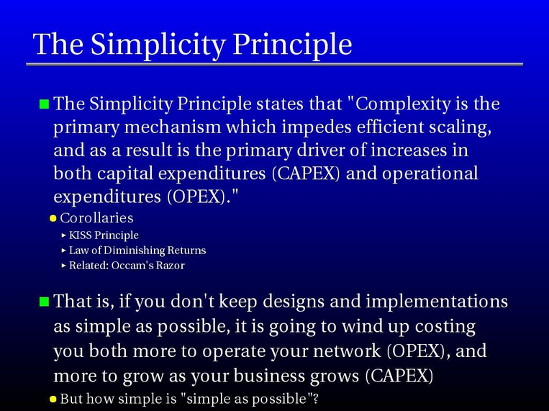
One Result of this Exploration was RFC 3439 (Some Internet Architectural Guidelines and Philosophy)
Mike O’Dell, by all accounts. See http://www.1-4-5.net/~dmm/talks/NANOG26/complexity_panel/

Slide 7
All Cool But Still, What is Complexity?
Well, the “Simplicity Principle” didn’t tell us what complexity is or where it comes from
We thought it had to do with coupling and amplification
The “SP” itself had no explanatory or predictive power
Worse: Simplicity Principle approach contained a classic error
Confused symptoms (amplification, coupling) with root cause
Not to mention there was *no* theoretical/mathematical framework that we could lean on
Result: over the past 12+ years I’ve been working with folks in the Control Theory, Systems Biology, and Engineering communities to try to get at this question
and understand its practical implications for engineers (us)

Slide 8

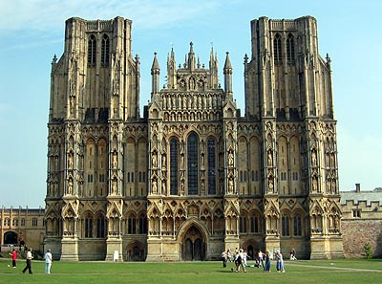
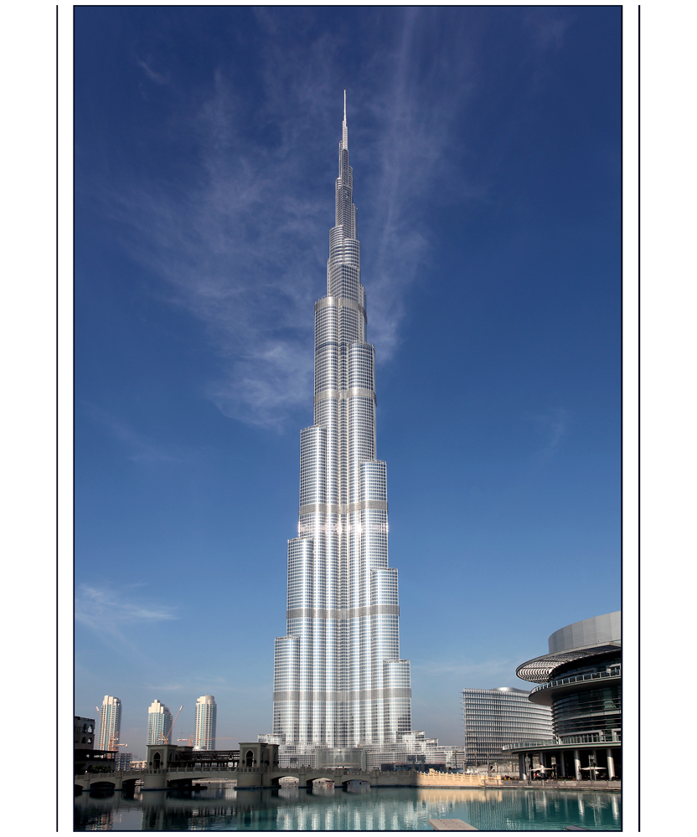
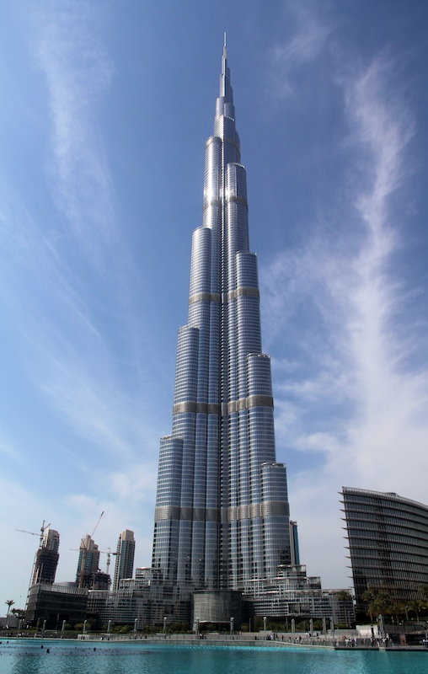
So I Started Looking At The History of (Building) Construction (why? Fred Harris)
Engineering Heuristics
Heuristic Materials “Science”
Mathematical Models
Heuristic Knowledge
Engineering Heuristics
Models
Basic idea: Engineering heuristics take us a long (long) way, but if we want to scale
beyond a certain point (say, build a 1000m tall building) we need a model of the
building so we predict its behavior (likely including some knowledge of physics)

Slide 9
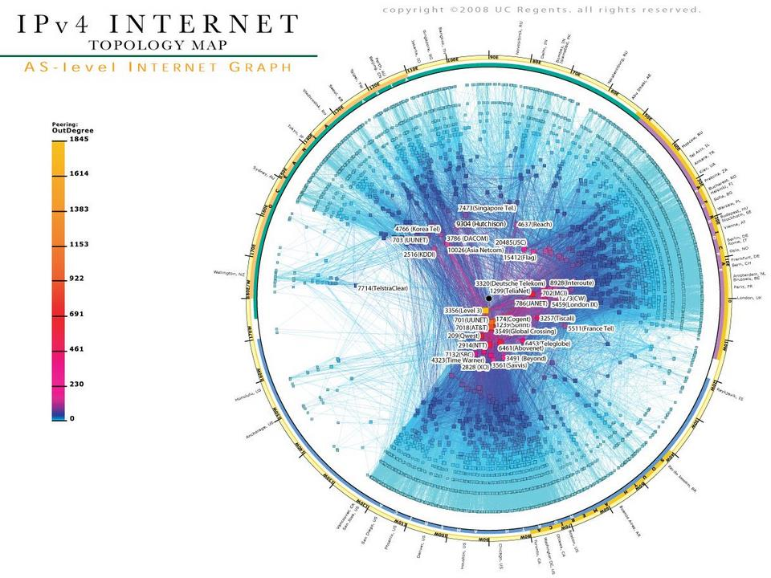

Applied to Scaling the Internet?
2^32
2^128
Engineering Heuristics
(sort of)
????
96 binary orders of magnitude
(ok, call it half)

Slide 10
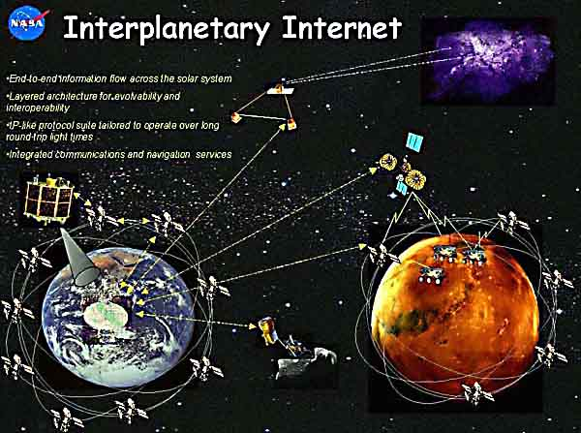
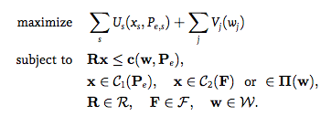
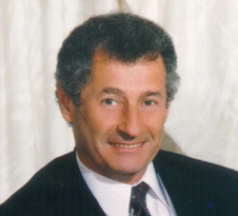
Carrying on the Analogy…
The basic assumption here is that to get to far greater levels of scale and functionality we’re going to need some kind of theoretical framework (models) that we can use to understand, design, build and operate these networks.
2^32
2^128
Engineering Heuristics
Models
Well, sort of…
Graphic courtesy CAIDA

Slide 11
So Goals for this Talk
Characterize the essential features of complexity
and where find complexity both technological and biological systems
Examine fundamental tradeoffs
that are made in complex systems
Explore universal architectural features
and how they are related to tradeoffs and complexity
Describe the relationship between complexity, tradeoffs, and layering
and how they can be part of a useful theoretical framework
Begin to Bridge the Engineering and Theory Networking Communities
Theorists need to know what engineers known (what is real¹), and
Engineers need the tools that we can get from theorists…
1 “Engineers always know first” – John Doyle

Slide 12
Said Another Way…
The major goal of this talk is to open up our thinking about what the essential architectural features of our network are, how these features combine to provide robustness (and its dual, fragility), and how the universal architectural features that we find in both technological and biological networks effect Internet robustness, scalability and evolvability.

Slide 13
Agenda
Too many words, too many slides ☺
This talk is about thinking about networking in new ways
Motivation and Goals for this Talk
What is Complexity and Why is it Hidden?
Robustness, Fragility, and Complexity
The Architecture of Complex Systems
Universal Architectural Principles
A Few Conclusions and Q&A if we have time

Slide 14
Ok, what is Complexity? (and why is it hidden)
Complexity is (mostly) hidden structure that arises in systems
Its purpose is to create robustness to environmental and component uncertainty
Hidden?
Anti-lock/anti-skid brakes, packet loss (TCP), linux kernel, power grids, cloud stacks, SDN controllers, lunar landing systems, …
You don’t notice they are there…until they fail
often catastrophically
Why Hidden?
the hidden nature of complexity is a fundamental property of these systems
derives from universal architectural principles of complex systems (layering, constraints that deconstrain)
and is required to make robustness and evolvablity compatible
But isn’t complexity evil?
and we’ll get to what robustness is in a sec…

Slide 15
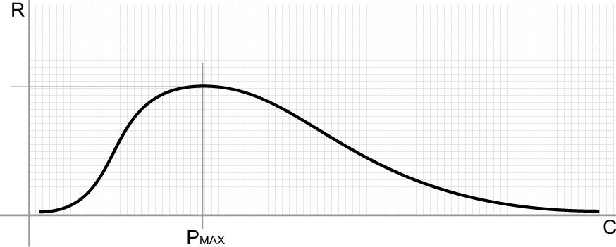
Complexity Isn’t Inherently “Evil”
Domain of the Robust
Domain of the Fragile
A system needs complexity to achieve robustness
(it’s a tradeoff)
Increasing number of policies, protocols, configurations and interactions (well, and code)

Slide 16
So What Then is Robustness? Robustness is a Generalized Feature of Complex Systems
Scalability is robustness to changes to the size and complexity of a system as a whole
Reliability is robustness to component failures
Efficiency is robustness to resource scarcity
Modularity is robustness to component rearrangements
…
So robustness is a very general idea
and captures many of the features we’re seeking from the network

Slide 17
A Bit More Formally
Robustness is the preservation of a certain property in the presence of uncertainty in components or the environment
Obviously a core Internet design principle
Systems Biology: Biological systems are designed such that their important functions are insensitive to the naturally occurring variations in their parameters.
Limits the number of designs that can actually work in the real environment
Exact adaptation in bacteria chemotaxis
Fragility is the opposite of robustness
Another way to think about fragility
Technical: You are fragile if you depend on 2nd order effects (acceleration) and the “harm” curve is concave
A little more on this in the next few slides…
A system can have a property that is robust to one set of perturbations and yet fragile for a different property and/or perturbation → the system is Robust Yet Fragile
Or the system may collapse if it experiences perturbations above a certain threshold (K-fragile)
For example, a possible RYF tradeoff is that a system with high efficiency (i.e., using minimal system resources) might be unreliable (i.e., fragile to component failure) or hard to evolve
VRRP , ISSU, HA, TE, {5,6,7..}-nines, …
Complexity/Robustness Spirals

Slide 18
Robust Yet Fragile?
(seems like a contradiction)
[a system] can have
[a property] that is robust to
[a set of perturbations]
Yet be fragile for
[a different property]
Or [a different perturbation]
Fragile
Recent results suggest that the RYF tradeoff is a hard tradeoff that cannot be overcome¹
This is profound: If you create robustness somewhere you will create fragility somewhere else…OK, but where?
Network Engineering, along with most other engineering disciplines, does not explicitly (or otherwise) account for this effect
Robust
Harm Function: Concave → Fragile, Convex → Robust
¹ See Marie E. Csete and John C. Doyle, “Reverse Engineering of Biological Complexity”,
http://www.cds.caltech.edu/~doyle/wiki/images/0/05/ScienceOnlinePDF.pdf

Slide 19
Interestingly, Fragility and Scaling are Related
A bit of a formal description of fragility
Let z be some stress level, p some property, and
Let H(p,z) be the (negative valued) harm function
Then for the fragile the following must hold
H(p,nz) < nH(p,z) for 0 < nz < K
→ A big event hurts non-linearly more than the sum of small events
For example, a coffee cup on a table suffers non-linearly more from large deviations (H(p, nz)) than from the cumulative effect of smaller events (nH(p,z))
So the cup is damaged far more by tail events than those within a few σ’s of the mean
Sensitivity to tail events → RYF
Too theoretical? Perhaps, but consider: ARP storms, micro-loops, congestion collapse, AS 7007, …
BTW, nature requires this property
Consider: jump off something 1 foot high 30 times v/s jumping off something 30 feet high once
So when we say something scales like O(n²), what we mean is the damage to the network has constant acceleration (2) for weird enough n (e.g., outside say, 3 σ)
Again, ARP storms, congestion collapse, AS 7007, DDOS, … → non-linear damage
Coffee cup example courtesy Nassim Taleb. See http://www.fooledbyrandomness.com

Slide 20
So Its All About (RYF) Tradeoffs
Biology and technology
robust
Find a new
job
Robustness
Tradeoff Frontier
fragile
Physics
simple
hard
Complexity

Slide 21
Robust
BTW, RYF Behavior is Everywhere
Yet Fragile
Efficient, flexible metabolism
Complex development and
Immune systems
Regeneration & renewal
Complex societies
Advanced Technologies
Obesity and diabetes
Rich microbe ecosystem
Inflammation, Auto-Im.
Cancer
Epidemics, war, …
Catastrophic failures
“Evolved” mechanisms for robustness allow for, even facilitate, novel, severe fragilities elsewhere. That is, they are RYF-Complex
Often involving hijacking/predation/exploitation of the same mechanism
We’ve certainly seen this in the Internet space (consider DDOS of various varieties)
These are hard constraints (RYF behavior is conserved)

Slide 22
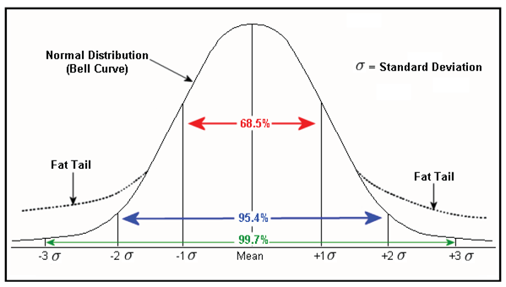
Summary: Understanding RYF is The Challenge
It turns out that managing/understanding RYF behavior is the most essential challenge in technology, society, politics, ecosystems, medicine, etc. This means…
Understanding Universal Architectural Principles
Look ahead: Layering, Bowties/Hourglasses, Constraints that Deconstrain
Managing spiraling complexity/fragility
Not predicting what is likely or typical
But rather understanding what is catastrophic
or in Taleb’s terminology, that which is fat tailed
And BTW, it is much easier to create the robust features than it is to prevent the fragilities
And as I mentioned, there are poorly understood “conservation laws” at work¹
Bottom Line
Understanding RYF behavior and associated tradeoffs means understanding network architecture and the hidden nature of complexity
¹ See Marie E. Csete and John C. Doyle, “Reverse Engineering of Biological Complexity”,
http://www.cds.caltech.edu/~doyle/wiki/images/0/05/ScienceOnlinePDF.pdf

Slide 23

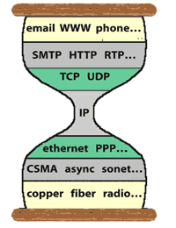

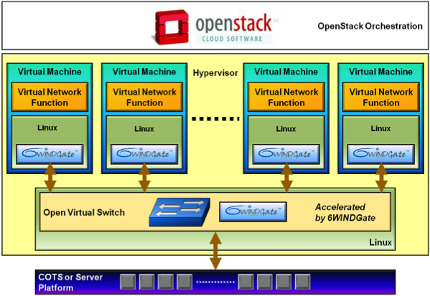
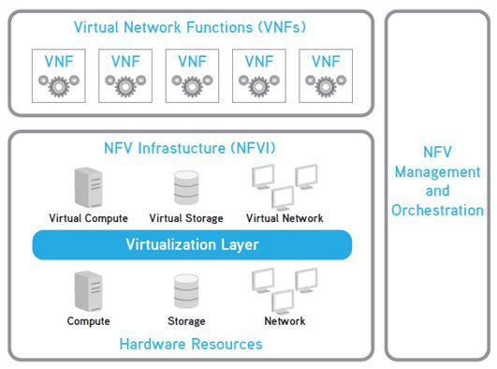


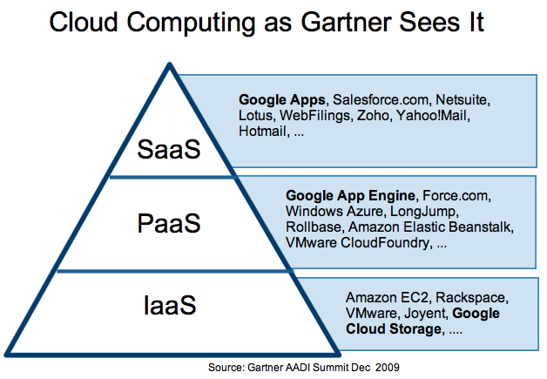




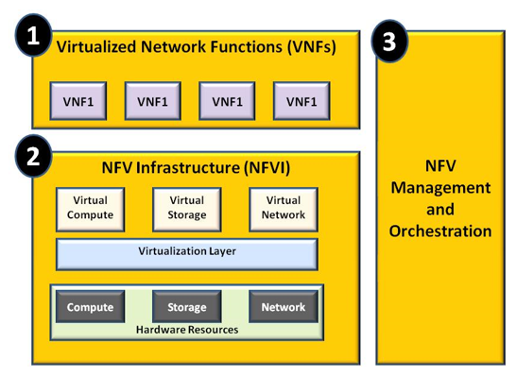


BTW, What is our Architecture? (and what tradeoffs are being made)
Cloud, NFV, SDN, Carrier Grade,
APIs, Standards…
But what about…
So what are the fundamental tradeoffs that we are making, and is there a more general way to think about them? But first…

Slide 24
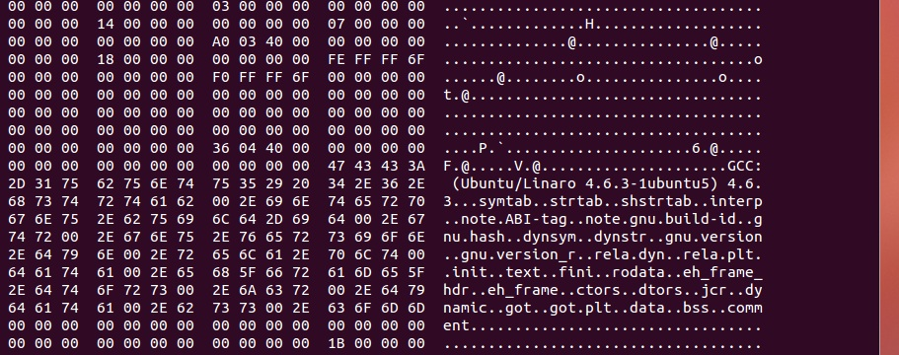
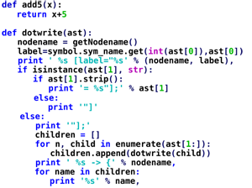
What tradeoffs are embedded in what we do everyday?
What tradeoffs are being made here?
Speed vs. flexibility?

Slide 25
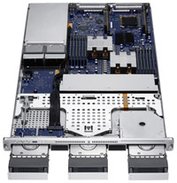
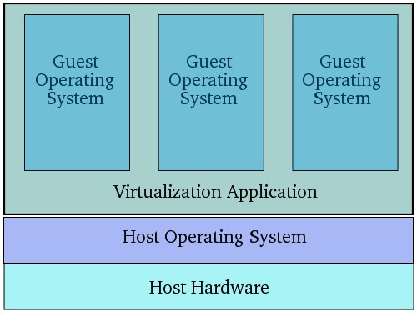
How About Here?
Speed vs. flexibility (bare metal vs. VM vs. container)?

Slide 26
Summary: Common Tradeoffs
Binary machine code vs. (interpreted) higher-level language
VM vs. bare metal (vs. container)
Fast path vs. slow path
Hardware vs. software
Convergence time vs. state
…
But what are the essential features of these tradeoffs?
What is fundamental in the tradeoff space?
And are there “laws” governing these tradeoffs?
And can we derive useful engineering laws from these “laws”?
And how do they relate to RYF-complexity?

Slide 27
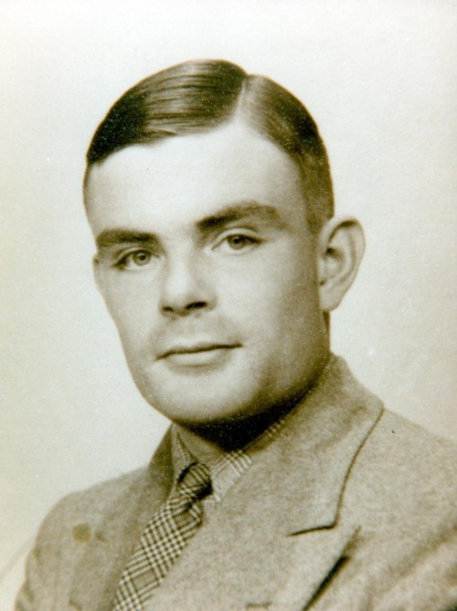
Turns out that RYF tradeoffs are fundamental
Example: Computational Complexity
Layering, Formal Systems, Hard Tradeoffs
robust
Slow
Architecture
Robustness
Impossible (law)
Fast
ideal
fragile
simple
hard
Flexible
Inflexible
General
Special
Complexity
Original slide courtesy John Doyle

Slide 28
Drilling down a bit on the Computational Complexity Tradeoff Space (changing axes)
Really slow
UTMs
Slow
hard limits
Fast
Undecidable
⊃ Decidable
⊃ NP
⊃ P?
Flexible/
General
Inflexible/
Specific
Notes:
.

Slide 29
Another Example: Feedback Control Theory
(Gain/Sensitivity Tradeoff In Feedback Control)
Bode Sensitivity Integral
Low
Tradeoff ≈ Law
Gain
Feasible Frontier
tradeoff
Impossible
ideal
High
Precise
Sloppy
Precision

Slide 30
Example: Laminar Flow
fragile
Laminar
Control?
?
robust
efficient
wasteful

Slide 31
Fragile
Slow
In reality the tradeoff
space is of higher dimension
Fast
Robust
Cheap
Flexible
Inflexible
Expensive
Efficient vs Robust
Hopefully not too high dimension: The Curse of Dimensionality

Slide 32
Agenda
Too many words, too many slides ☺
This talk is about thinking about networking in new ways
Motivation and Goals for this Talk
What is Complexity and Why is it Hidden
Robustness, Fragility, and Complexity
The Architecture of Complex Systems
Universal Architectural Principles
A Few Conclusions and Q&A if we have time

Slide 33
The Architecture of Complex Systems
What we have learned is that there are universal architectural building blocks found in systems that scale and are evolvable. These include
Architecture/Layering
Laws, constraints, tradeoffs
Protocol Based Architectures
Massively distributed with robust control loops
Consequences
Hidden RYF Complexity
Hijacking, parasitism, predation

Slide 34
So What Do We Know About Architecture?
(What is the fundamental architecture of complex systems?)
Deconstrained
(Applications)
Diverse
Apps
Core Protocols
Constrained
and hidden
OS
Diverse
Deconstrained
(Hardware)
HW
Slide courtesy John Doyle

Slide 35
Bowties, Hourglasses and Layering
fan-in
of diverse
inputs
fan-out
of diverse
outputs
Bowtie
Universal Carriers
Diverse
function
Universal Architectural Principles
Universal
Control
Hourglass
Bowties for flows within layers (protocol)
Hourglasses for layering of control (stack)
Constraints that Deconstrain
Diverse
components

Slide 36
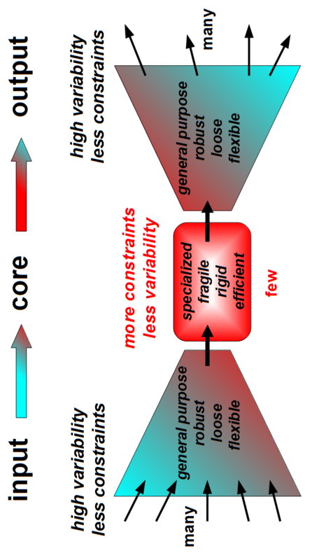
Bowties 101 Constraints that Deconstrain Schematic of a “Layer”
For example, the reactions and metabolites of core
metabolism, e.g., Adenosine Triphosphate (ATP) metabolism,
Krebs/Citric Acid Cycle, … form a “metabolic knot”. That is, ATP
is a Universal Carrier for cellular energy.
Processes L-1 information and/or raw material flows into a “standardized” format (the L+1 abstraction)
Provides plug-and-play modularity for the layer above
Provides robustness but at the same time fragile to attacks against/using the standardized interface
See Kirschner M., and Gerhart J., “Evolvability”, Proc Natl Acad Sci USA , 95:8420–8427, 1998.

Slide 37
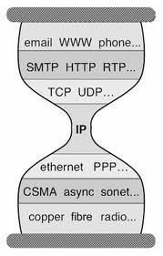
But Wait a Second Anything Look Familiar?
Bowtie Architecture
Hourglass Architecture
Comes down to whether you see layering as horizontal or vertical
The Protocol Hourglass idea appears to have originated with Steve Deering. See Deering, S., “Watching the Waist of the Protocol Hourglass”, IETF 51,
2001, http://www.iab.org/wp-content/IAB-uploads/2011/03/hourglass-london-ietf.pdf.
Notes:
Bowties for flows w/in layers, and Hourglasses for layering of control

Slide 38
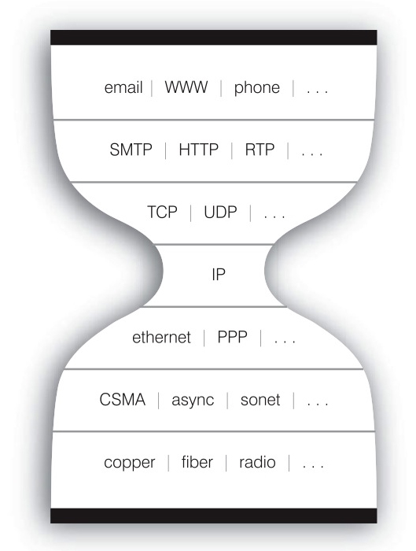
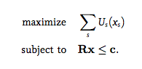
The Nested Bowtie/Hourglass Architecture of the Internet
Layering of Control
HTTP Bowtie
Input: Ports, Datagrams, Connections
Output (abstraction): REST
TCP/UDP Bowtie
Input: IP Packets
Output (abstraction): Ports, Datagrams, Connections
REST
Connections
Datagrams
Ports
HTTP(S)
REST
Layering of Control/Abstractions
TCP/UDP
Connections
Datagrams
Ports
IP Packets
Flows within Layers
Reverse/forward engineering of TCP as a Network Utility Maximization (NUM) problem

Slide 39
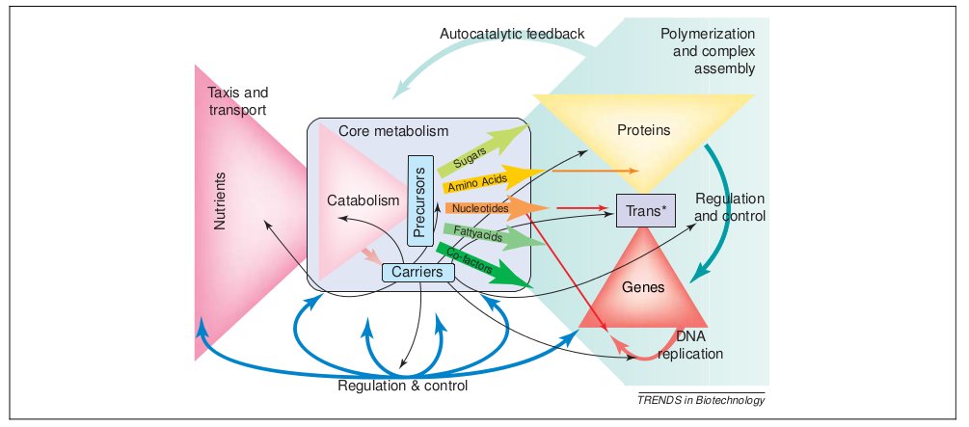
In Practice Things are More Complicated The Nested Bowtie/Hourglass Architecture of Metabolism
See Csete, M. and J. Doyle, “Bowties, metabolism and disease”, TRENDS in Biotechnology, Vol. 22 No. 9, Sept 2004

Slide 40
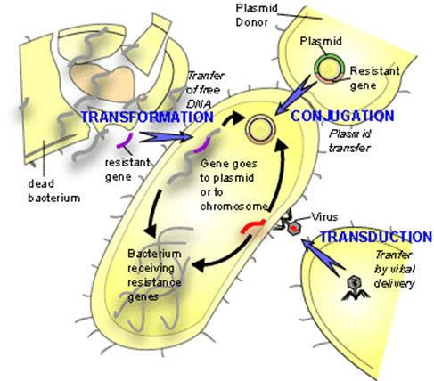
Key Architectural Concept: Horizontal Transfer
HGT
Deconstrained
(Applications)
Diverse
Apps
Horizontal App Transfer
Layered Architectures make Robustness and
Evolvability Compatible
OS
OS
H*T
HW
Diverse
Deconstrained
(Hardware)
Horizontal HW Transfer

Slide 41
Putting it all Together
Architecture, Layering, and Tradeoffs
Unconstrained/Diverse
Slow
Apps
Tradeoff “Frontier”
OS
Constrained/Hidden
HW
Fast
Unconstrained/Diverse
Flexible
Inflexible
General
Special

Slide 42
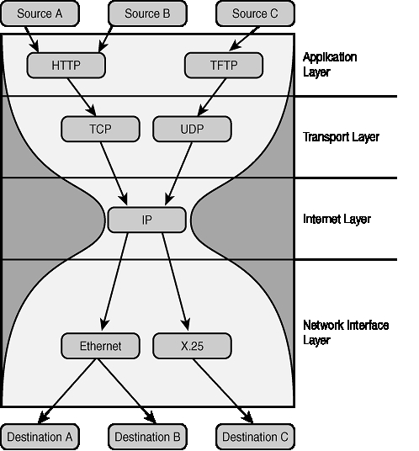
Example: Internet Architecture
Unconstrained/Diverse
Slow
Apps
OS
Constrained/Hidden
Standardized Contracts
HW
Fast
Unconstrained/Diverse
Flexible
Inflexible
General
Special

Slide 43
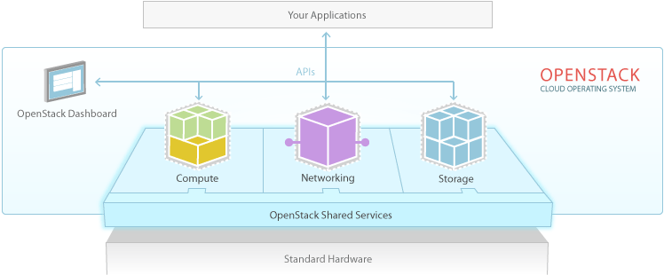
Example: OpenStack
Unconstrained/Diverse
Slow
Apps
OS
Constrained/Hidden
Standardized Contracts
HW
Fast
Unconstrained/Diverse
Flexible
Inflexible
General
Special

Slide 44
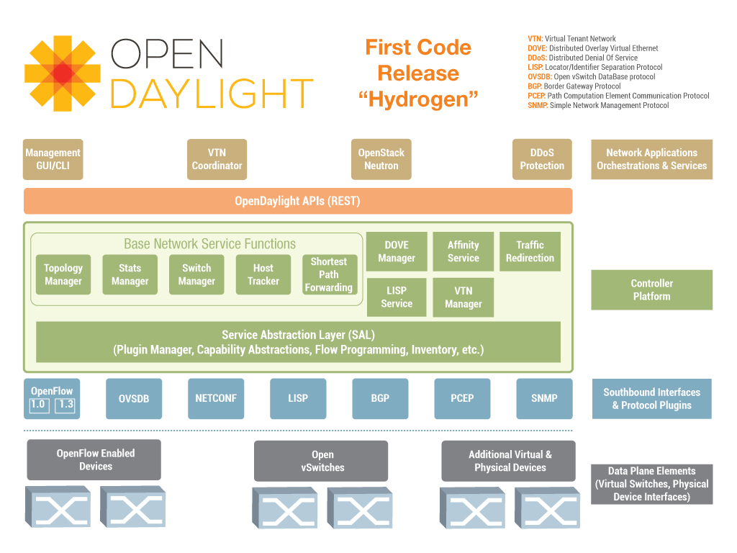
Example: SDN
Unconstrained/Diverse
Slow
Apps
OS
Constrained/Hidden
Standardized Contracts
HW
Fast
Unconstrained/Diverse
Flexible
Inflexible
General
Special

Slide 45
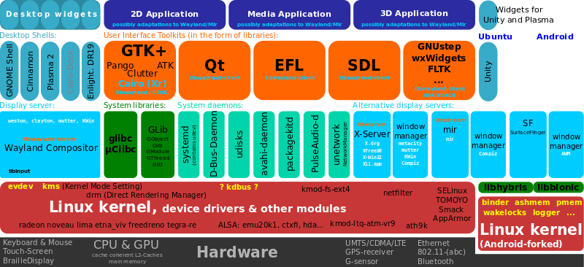
Linux Kernel?
OS

Slide 46
We gotta do some Systems Biology (come on, its all just networking ☺)
Biological systems have a similar architecture
Same tradeoff space
with of course different implementation than our network
Basically: diverse apps and h/w with a hidden kernel
Constraints that deconstrain
Many good examples of layered networks
Very (brief) examples
Bacteria
Vestibular Ocular Reflex (VOR)

Slide 47
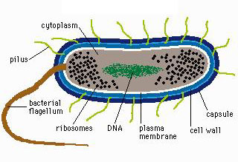
Layered Bacteria
Apps
Slow
Cheap
HGT
DNA repair
Mutation
DNA replication
Transcription
Translation
Metabolism
Signal…
OS
HW
Fast
Costly
Flexible
Inflexible
General
Special

Slide 48
A little more detail
DNA
New gene
Gene
RNA
RNAp
Transcription
Other
Control
mRNA
Amino
Acids
Slow
Cheap
Ribosomes
Translation
HGT
DNA repair
Mutation
DNA replication
Transcription
Translation
Metabolism
Signal…
Other
Control
Proteins
What could possibly go wrong?
Metabolism
Products
ATP
control feedback
Signal transduction
Fast
Costly
Flexible
Inflexible
General
Special

Slide 49


One More Example: The Vestibular Ocular Reflex (VOR)
Reflex eye movement that stabilizes images on the retina during head movement
Mechanism
Vestibular Ocular Reflex
Slow
vision
Tradeoff
VOR
Fast
Flexible
Inflexible

Slide 50
eye
vision
slow
Act
delay
Slow
vision
Fast
Flexible
Inflexible

Slide 51
eye
vision
fast
slow
Act
delay
Slow
vision
VOR
Fast
Flexible
Inflexible

Slide 52
eye
vision
slow
Act
Highly
evolved
(hidden)
architecture
delay
Slow
vision
Fast
VOR
Flexible
Inflexible

Slide 53
vision
Prefrontal
Slow
Learn
Motor
Fast
Sense
Apps
OS
HW
Dig.
Lump.
Distrib.
OS
HW
Dig.
Lump.
Distrib.
Digital
Lump.
Distrib.
Lumped
Distrib.
Distrib.
Evolve
VOR
Reflex
Ideal?
Fast
Flexible
Inflexible
General
Special
BTW, can a new architecture beat the tradeoff?
Notes:
Notes: Please provide additional information here.

Slide 54

vision
Prefrontal
Slow
Learn
Motor
Fast
Sense
Apps
OS
HW
Dig.
Lump.
Distrib.
OS
HW
Dig.
Lump.
Distrib.
Digital
Lump.
Distrib.
Lumped
Distrib.
Distrib.
Evolve
VOR
Reflex
Fast
Flexible
Inflexible
General
Special
Be careful what you wish for…
http://packetpushers.net/artificial-intelligence-brains-networks-bugs-complexity/
Notes:
Notes: Please provide additional information here.

Slide 55
Agenda
Too many words, too many slides ☺
This talk is about thinking about networking in new ways
Motivation and Goals for this Talk
What is Complexity and Why is it Hidden
Robustness, Fragility, and Complexity
The Architecture of Complex Systems
Universal Architectural Principles
A Few Conclusions and Q&A if we have time

Slide 56
Hopefully I’ve Convinced You…
That there are Universal Architectural Features that are common to biology and technology
Laws, constraints, tradeoffs
Robust/fragile
Efficient/wasteful
Fast/slow
Flexible/inflexible
Architecture/Layering
Hidden RYF Complexity
Hijacking, parasitism, predation
Ok, but why is this useful?

Slide 57
Why is all of this Useful?
Robust systems are intrinsically hard to understand
RYF is an inherent property of both advanced technology and biology
Understanding general principles informs what we build
Software (e.g., SDN, NFV, Cloud, …) exacerbates the situation
And the Internet has reached an unprecedented level of complexity →
Need new/analytic ways of designing, deploying, and operating networks if we want to scale
Nonetheless, many of our goals for the Internet architecture revolve around how to achieve robustness…
which requires a deep understanding of the necessary interplay between complexity and robustness, modularity, feedback, and fragility¹
which is neither accidental nor superficial
Rather, architecture arises from “designs” to cope with uncertainty in environment and components
The same “designs” make some protocols hard to evolve
Can anyone say, um, IPv6 (or even DNSSEC)?
¹ See Marie E. Csete and John C. Doyle, “Reverse Engineering of Biological Complexity”,
http://www.cds.caltech.edu/~doyle/wiki/images/0/05/ScienceOnlinePDF.pdf

Slide 58
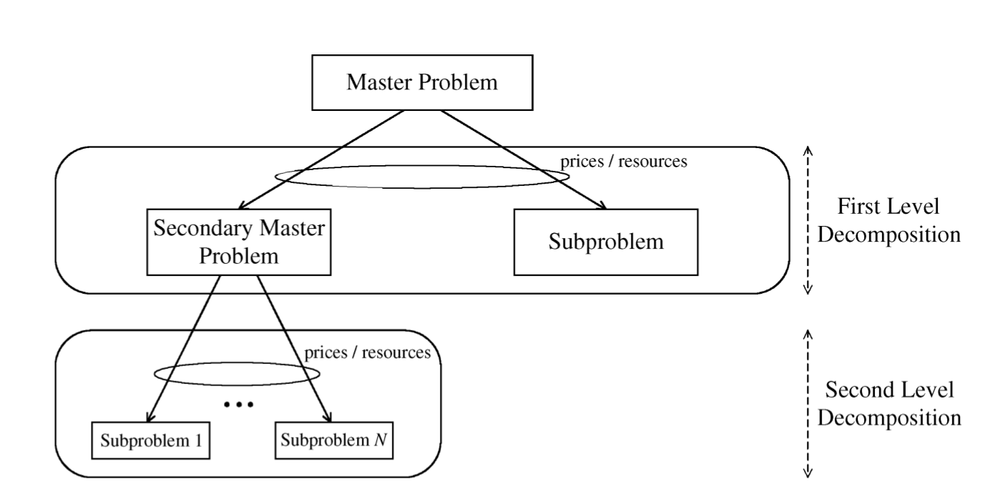
Why is all of this Useful, cont?
This much seems obvious
Understanding these universal architectural features and tradeoffs will help us achieve the scalability and evolvability (operability, deployability, understandability) that we are seeking from the Internet architecture today and going forward
Perhaps less obvious: This requires a mathematical theory of network architecture
Want to be able to analyze/compare/simulate/optimize all aspects of network design/operation
Mathematics the natural language for this
BTW, as engineers we solve problems (“engineers always know first”), but we can benefit from the tools that theory can provide to help us design/deploy/operate/optimize our networks
First Cut: “Layering as Optimization Decomposition: A Mathematical Theory of Network Architectures”¹
Network Utility Maximization (NUM)/Layering As Optimization (LAO)/Decomposition Theory
TCP and Stable Path Problem (BGP) reverse-engineered as Generalized NUM problems
Need something like LAO/G-NUM + “Constraints that deconstrain” view
Finally, some bridge building: Exploring the Intersection of Theory and Engineering: Universal Laws, Architecture, and SDN: http://conferences.sigcomm.org/sigcomm/2014/tutorial-theory+eng.php
1 http://www.princeton.edu/~chiangm/layering.pdf

Slide 59
Q&A
Thanks!

